Slide 1
Hackathon’25 : Solve Rubik’s Cube
Presented By: PUSHADAPU MOHANA VENKATA SIVA NAGA SAI

Slide 2
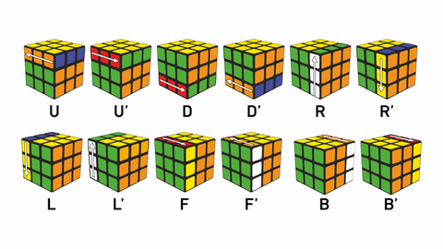
Solve Rubik’s Cube
Overview
Participants are challenged to design and implement an algorithm that can solve a standard 3x3 Rubik’s Cube from any scrambled state. The solution must mimic the real-world logic of solving a cube through a sequence of valid moves.
What We’re Looking For : 🔍
Problem-Solving Approach
How do you break down the problem?
How do you model the cube’s state and transitions?
Use of Data Structures
How do you represent the cube internally (e.g., arrays, trees, graphs)?
Use of efficient structures to track states and operations.
State Prediction Logic
Ability to track and predict cube state after each move.
Design of a move engine to simulate rotations and track permutations.
Algorithm Efficiency
How fast can your solution reach the solved state?
Complexity (time and space) of your algorithm.
Bonus Evaluation Areas
Creativity in solution design.
Visual simulation or cube UI (optional but Wow factor).
Scalability for different cube sizes (2x2, 4x4, etc.) : Optional
Deliverables:
Working algorithm (code)
Brief walkthrough/presentation of your approach
Output example(s) from your solver
It’s Not Just a Puzzle - It’s a Test of Mind, Math, and Moves!

Slide 3
Problem Breakdown & Approach
🔹 Step-by-step Breakdown of the Problem:
Input: Scrambled cube state using color data (via camera or manual input).
Goal: Return to the solved state using legal cube moves only (no shortcuts).
Output: A valid sequence of moves leading to the solved cube.
🔹 Real-World Solving Mimicked in Code:
Solve in layers (White Cross → First Layer → Middle Layer → Yellow Cross → Full Solve).
Respect move notations (U, D, R, L, F, B and their primes).
🔹 Key Decisions:
Avoid Kociemba; use manually implemented move logic and layered solving.
Design a flexible cube simulator to apply and track face rotations.
🔹 Tools Used:
Python
OpenCV (for capturing cube faces)
Custom logic for face rotations and solving sequences

Slide 4
Cube Modeling & Data Structures
Cube Representation:
The cube is modeled as a dictionary.
Each face holds 9 color values (3x3 grid) stored as a list.
🔹 Face Orientation:
Center color defines the face identity.
Piece positions are tracked relative to their face.
🔹 Data Structures Used:
Dictionaries – For easy access to each face.
Lists – To maintain sticker positions.
Move Mapping Tables – Define how each move affects adjacent faces.
🔹 Why This Works Well:
Fast read/write operations for simulation.
Easy to visualize and manipulate face turns.
Allows integration with both manual solving logic and future animation.

Slide 5
Move Engine & Simulation Logic
🔁 Move Engine Design:
Each valid move
Rotating the face (clockwise, counter-clockwise, 180°).
Updating affected edge and corner stickers on adjacent faces.
🔗 Dependencies Maintained:
Face rotations correctly update neighboring pieces.
Sequence of moves is applied step-by-step, simulating real rotations.
Designed for Extensibility:
Easily expandable for more complex solving strategies.
Logic is reusable across manual and automated approaches.

Slide 6
White Cross Solver (Without Kociemba)
Objective: Begin the solving process by forming a white cross around the white center face.
Logic Breakdown:
Identify white edge pieces (with white + one adjacent color).
Track positions using relative face locations (e.g., U-F, D-B).
Rotate layers to bring white edges to the bottom (D-face).
Match adjacent color with corresponding center.
Rotate the edge to its final position on the top (U-face) with correct orientation.
Move Engine:
Implemented basic face moves (U, D, L, R, F, B with ‘ and 2 variants).
Tracks and applies permutations for edges and corners.
Records steps into a solution[] list for visual replay.
Challenges Handled:
Color misdetection corrected manually after capture.
Ensures edge is placed with proper color alignment (not just position).

